Slide 1
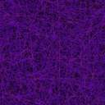


Understanding ionic Li diffusion in crystalline Li₃PS₄ and Li₁₀GeP₂S₁₂ solid electrolytes, via ab-initio simulations
Nima Leclerc, Alex Hall, and Nicole Adelstein
School of Engineering
Department of Chemistry and Biochemistry
San Francisco State University
nlecler1@mail.sfsu.edu
Notes:
Hello everyone, thank you for the introduction and thank you for coming to this talk. today I will discuss my research findings on understanding Li diffusion in crystalline LPS and LGPS electrolytes, using quantum mechanical simulations.

Slide 2
Understanding Li⁺ diffusion diffusion behavior in amorphous and crystalline Li₃PS₄ solid electrolytes, via ab-initio simulations
Prelude: Crystalline Comparisons
Notes:
As many of you may have noticed, I initially planned to discuss the diffusion in the amorphous LPS system. Today I will present our preliminary results, comparing the diffusion in LPS and LGPS, which will give insight into the anomalous amorphous LPS diffusivitivity.

Slide 3
Outline
Why solid state?
Density Functional Theory (DFT) for predicting material properties
III. Li₃PS₄ (LPS) and Li₁₀GeP₂S₁₂ (LGPS) electrolytes
IV. Diffusion mechanisms and results
Notes:
Firstly, I will incentivize our study of this class of materials by introduction their applications.
Then, I will delve into the qualitative and quantitative descriptions of diffusion mechanisms in the two systems.

Slide 4
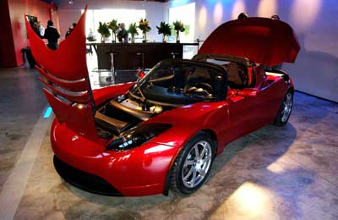

Current Batteries – Too expensive, too big, and too unsafe.
Tesla® all-electric vehicle .
2
Notes:
The driving force of this research is to improve upon the current state of Li organic-based electrolyte batteries, found in electric vehicles and consumer electronics. Current batteries are too expensive, or we could all afford Teslas, big and unsafe. In particular, organic solvent batteries are unsafe because Li can form dendrites across the electrolyte, leading to shorts and fires, as in this picture. For those of you Samsung engineers, this may be something to consider.
Solid state electrolytes address many of the issues plaguing current organic and polymer electrolyte.

Slide 5
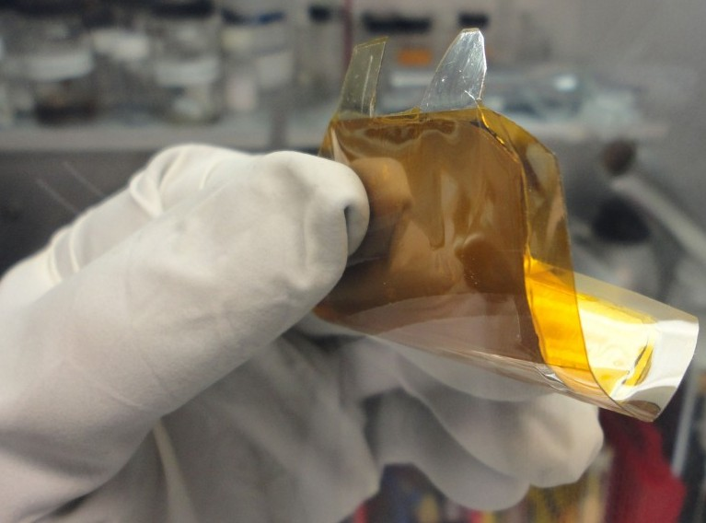
Future Batteries: ALL SOLID STATE
The Next Generation of Energy Storage
Applied Materials Inc.® thin-film Solid State Battery (LIPON electrolyte)
Notes:
Here is an example of an all solid-state-battery manufactured by Applied Materials for wearable electronics. These use a solid LiPON amorphous electrolyte, which is widely used in industry today. But The conductivity of LIPOn is LOW, thus there is a push to find betrer electrolyte materials. Out focus is to improve these electrolyte materials, using computation.

Slide 6
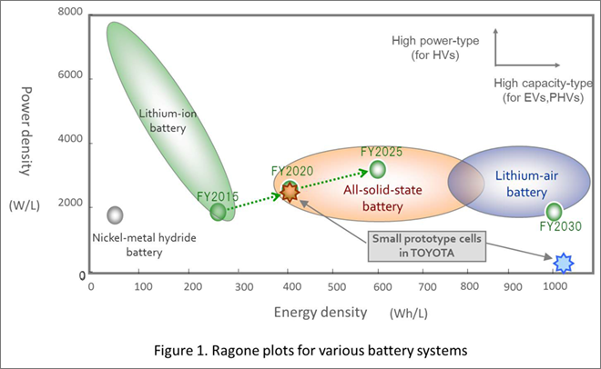
Solid State Batteries can increase Power and Energy densities Simultaneously
Current Li-ion batteries cannot have both high power and energy densities
Solid state batteries can achieve both!
Charles Morris, “Toyota researchers develop all-solid-state Li-ion batteries”. 2014
Notes:
As many of you may recall, a myriad of material properties are typically strongly coupled to one another. For instance, similar to how it is a challenge to design a building that is both really light weight and really…really strong, it is difficult to manufacture a battery that is both high in energy density and power density.
As you can see in this schematic from Toyota researchers, current Li-ion batteries cannot have both high power density (point to axis) and energy density (point to axis). In constrast, solid state battery can achieve simultaneous improvements of power and energy density.

Slide 7
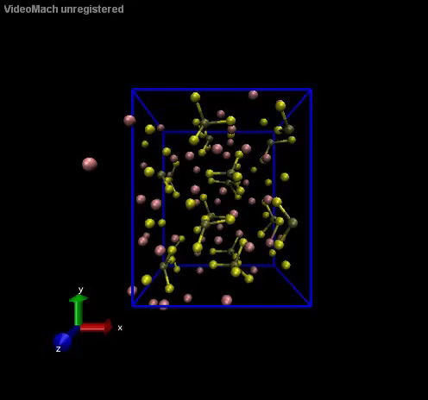
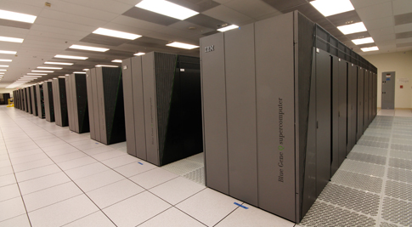
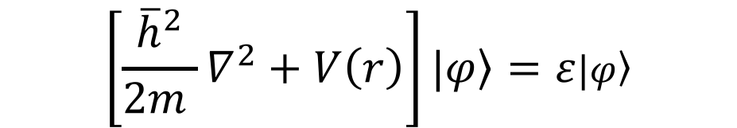
Large-scale predictive simulations require Density Functional Theory (DFT)
$$\left[\frac{{\overline{h}}^{2}}{2m }∇^{2}+V\left(r\right)\right]|\left.φ\right\rangle =ε|\left.φ\right\rangle$$
No a-priori assumptions about bonding character between Li+ and lattice
Molecular dynamics (MD) predicts diffusion mechanisms
MD
LPS MD system, 700 K
LLNL Computing Center
Nima Leclerc, San Francisco State University
Notes:
The goal of our computational simulations is to develop an atomistic understanding of diffusion mechanisms. An example Molecular dynamics simulation of LPS is shown here. We focus on identifying the chemical and physical explanations of diffusion mechanisms in electrolytes. We do not want to assume anything about the bonding interaction between Li+ and the other atoms in the electrolytes. To calculate the nature of bonds, we need to calculate the electronic structure, and to simulate diffusion, we need energies. As you know, this is done with the Schrodinger equation. Our systems are large so we run our DFT simulations with help from Livermore National Laboratory’s supercomputers.

Slide 8
Why solid state?
Density Functional Theory (DFT) for predicting material properties
III. Li₃PS₄ (LPS) and Li₁₀GeP₂S₁₂ (LGPS) electrolytes
IV. Diffusion mechanisms and results
Notes:
Now that I’ve given a brief introduction, let’s motivate our study of LGPS and LPS.

Slide 9
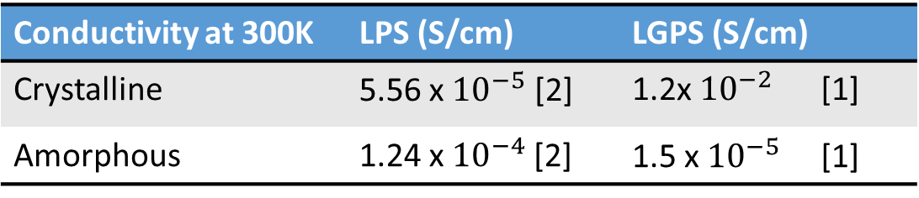
Why is σ(LGPS) greater than σ(LPS)?
β- Li₃PS₄ :
Amorphous σ >> crystalline σ
Amorphous electrolytes improve safety and manufacturing
Electrolyte electrochemical stability windows [3]
Conductivity at 300K | LPS (S/cm) | LGPS (S/cm)
Crystalline | 5.56 x ${10}^{−5}$ [2] | 1.2x ${10}^{−2}$ [1]
Amorphous | 1.24 x${10}^{−4}$ [2] | 1.5 x${ 10}^{−5}$ [1]
Li₁₀GeP₂S₁₂ :
Composition and structure is very similar to LPS
One of the fastest Li⁺ solid electrolytes
Crystalline σ >> amorphous σ
[1] Mori et al. Solid State Ionics (2017)
[2]Hayamizu et al. Solid State Ionics (2015)
[3] Zhu et al. Acs Applied Materials & interfaces (2015)
LGPS and LPS: both not very electrochemically stable. .
Is the LGPS structure better?
Notes:
Why study LPS and LGPS? Well, both LPS and LGPS have been studied extensively, both experimentally and computationally. It was shown that LPS experiences far greater conductivity in its amorphous phase, as you can see in this table. This is not typical of most solid electrolytes. For instance, you can see the opposite trend with amorphous and crystalline LGPS. We are interested in amorphous electrolytes because they improve both safety and manufacturing, but high conductivity in the amorphous phase is anomalous. Thus, our interest in LPS.
We want to simulate the LGPS system, because it has a very similar structure and composition to that of LPS, as you will see in the next slide. Additionally, it is one of the fastest Li solid conductor. Comparison of diffusion may give insight into the high amorphous conductivity in LPS.
The main drawback of both systems is that both have relativley ssmall electrochemical stability windows, as you can see in this plot depicting the ES windows of many convential electrolyte materials. LPS and LGPS are some of the most unstable. But, we still want to study these to understand and compare their high Li diffusivities.
We start with: why is the conductivity of LGPS >> than LPS? Could this be because of structure?

Slide 10
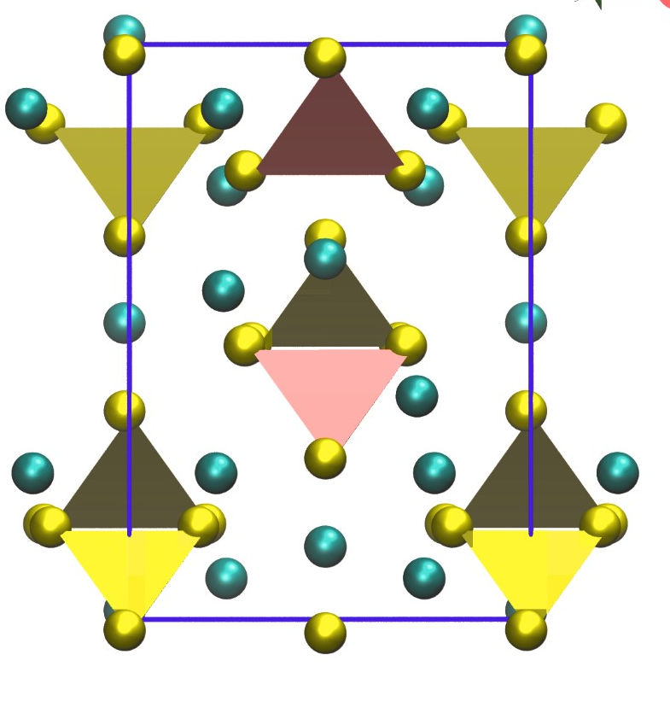
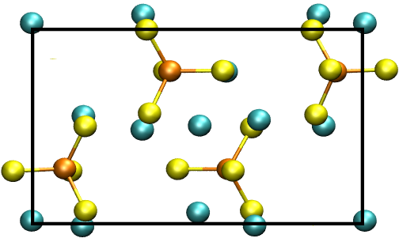
Do the 1D channels cause the higher diffusivity?
LPS
LGPS
Similarities and differences:
Disconnected tetrahedra, But in LGPS: substitute Ge⁴⁺ for P⁵⁺, which improves Li⁺ concentration
Zig-zag chains of PS₄/GeS₄
LGPS: along two axes (creates 1 D channels)
LPS: 1 axis
Orthorhombic
LGPS: P4₂/nmc
LPS: Pnma
1D
1D
Predominantly 3D diffusion
Fast 1D diffusion
Is the LGPS mechanism faster?
Notes:
Note that both structures have zig-zag chaings of tetrahedra. The main structural difference is that in LGPS there are zig-zag chains in 2 axes, but in LPS the chains form only along one axes.
The zig-zag chains border 1D channels of Li in both structures. However, in LPS there is predominantly 3D diffusion, while in LGPS diffusion is much faster in the 1D channels along the c axis.
Finally, both structures are orthorhombic, but have different space groups. The site symmetries of the Li have been hypothesized to affects the diffusivity.
There is nothing obvious about the structures that would lead one to think LGPS have faster diffusivity, so we need to look at the diffusion mechanisms with MD.

Slide 11
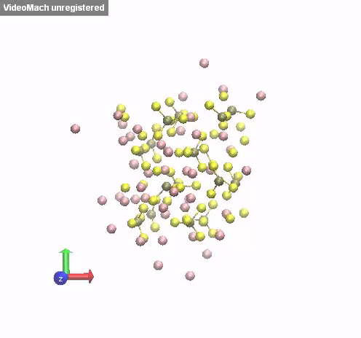
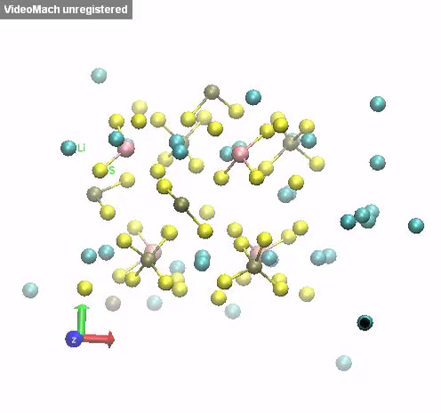
Do the 1D channels in LGPS cause the higher diffusivity?
Simulations by Joel Varley (LLNL) and analysis by Alex Hall (SFSU).
Obviously there is faster diffusivity along the LGPS 1D channels, but it is enough?
Notes:
MOVIES.
Here you can put some more computational details. Don’t forget to thank ALEX and JOEL VARLEY at LLNL during the movies.

Slide 12
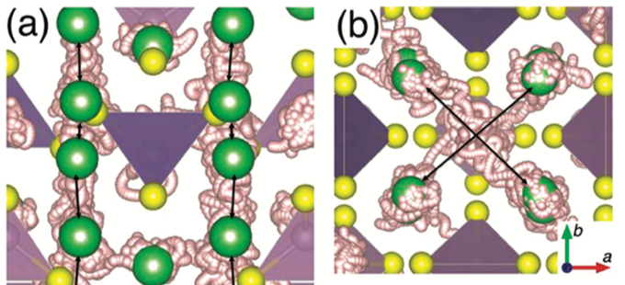
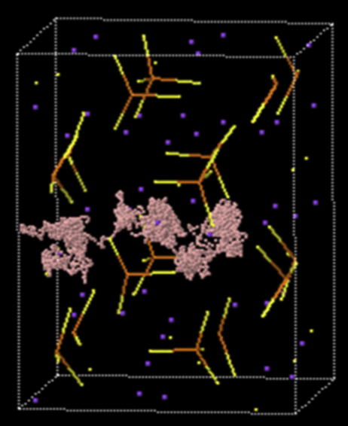
Do the 1D channels in LGPS cause the higher diffusivity?
1D channels are not enough for poly-crystalline materials.
LGPS: Many similar energy tetrahedral sites give low E_{a} in 1D (0.17 eV [0])
3D diffusion from a-b planes that connect the 1D channels
LPS: Many tetrahedral sites, but also square planar sites
3D diffusion is different than LGPS 1D channels
If LGPS mechanism is better = lower E_{a}
Else, significant correlated motion in LGPS may lead to high conductivity.
[0] Mo, Y. et al. Chemistry of Materials, 24, 15-17 (2012)
[1] Yang, J. and Tse, J. Computational Materials Science 107, 134-138 (2015).
Nima Leclerc, San Francisco State University
Notes:
In a polycrystalline material you need 3D diffusion
Previous simulations of LGPS have hypothesized that the superior diffusivity comes from low energy jumps between tetrahedral sites.
The authors identify many of these low energy tetrahedral sites in the lattice.
These low energy jumps promote the fast diffusion in the 1D channels along the c-axis, but there is also significant diffusion in the a-b planes that connect the 1D channels.
In contrast, there is not channel like diffusion in LPS, but rather general 3D diffusion. There are also many tetrahedral sites in LPS, but there are also a number of square planar sites. So the different mechanisms could be the causes of the outstanding conductivity in LGPS. If that is the case, the activation energy for LGPS should be much lower than in LPS. If the activation energies are similar, then there must be another reason. One such reason could be correlated motion of Li in LGPS, which has been observed in many simulations. The correlated motion could be aided by rotation of the PS4 tetrahedra, which could push Li along in a paddle wheel mechanism. Simulations have seen some evidence of PS4 rotations in both LPS and LGPS.
THIS SLIDE NEEDS CITATIONS. I WILL HELP WITH THAT LATER.

Slide 13
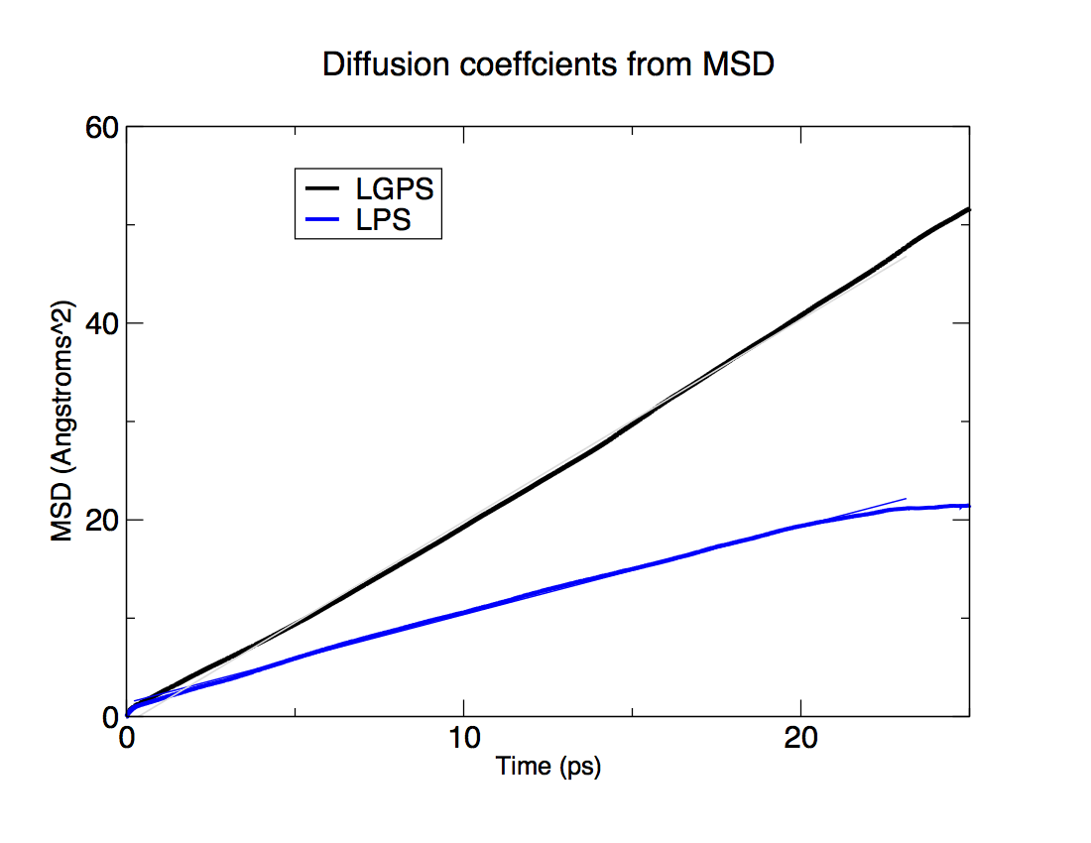
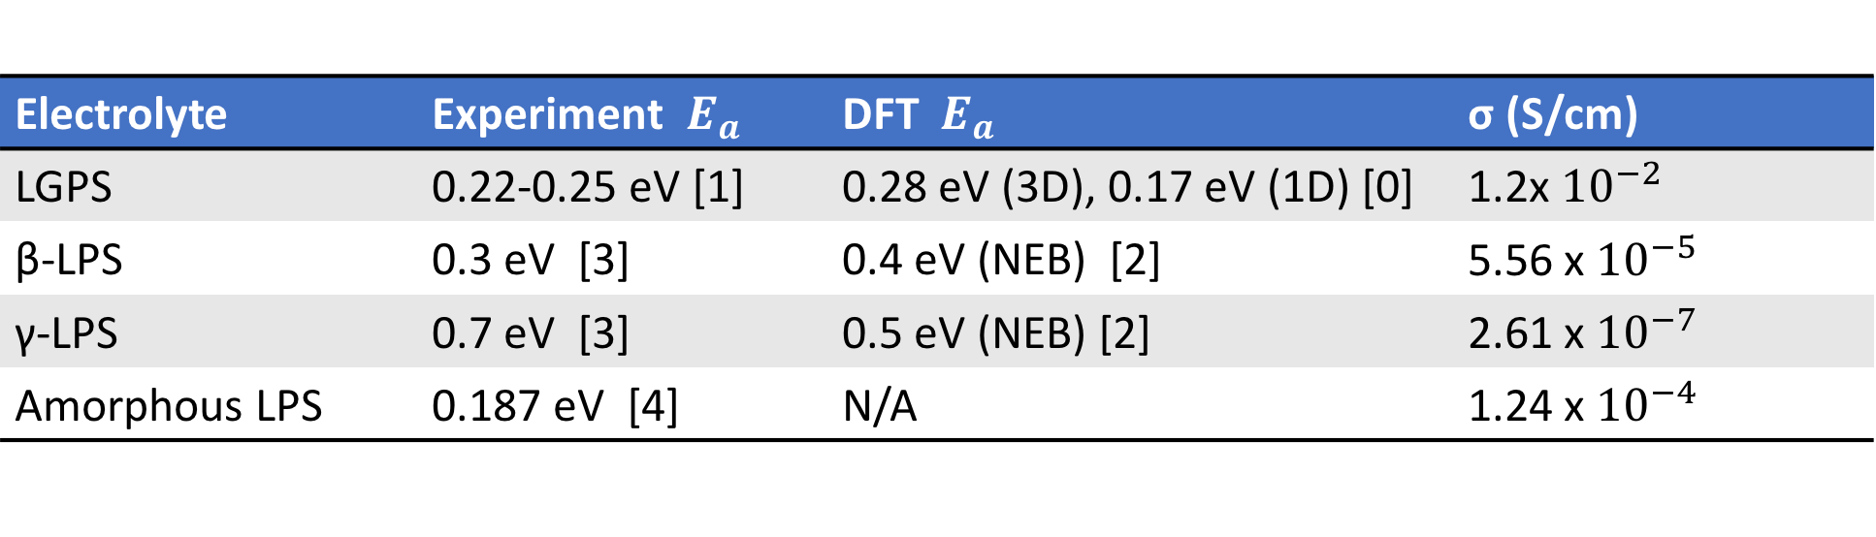
Activation energies not very different for LSP and LGPS
Electrolyte | Experiment $E_{a }$ | DFT ${ E}_{a }$ | σ (S/cm)
LGPS | 0.22-0.25 eV [1] | 0.28 eV (3D), 0.17 eV (1D) [0] | 1.2x ${10}^{−2}$
β-LPS | 0.3 eV [3] | 0.4 eV (NEB) [2] | 5.56 x ${10}^{−5}$
γ-LPS | 0.7 eV [3] | 0.5 eV (NEB) [2] | 2.61 x ${10}^{−7}$
Amorphous LPS | 0.187 eV [4] | N/A | 1.24 x${10}^{−4}$
𝝙E_{a} ≠ 𝝙σ for LGPS vs. LPS
Correlated motion PS₄ rotations (paddle wheel)?
Disorder: LGPS=GeS₄, LPS=amorphous [5]
Ideal volume: LGPS=Ge>P, LPS=amorphous
Note, average volume/tetrahedra in LGPS <= LPS
[0] Mo, Y. et al. Chemistry of Materials, 24, 15-17 (2012)
[1] Kamaya, N. et al. A lithium superionic conductor. Nature Mater. 10, 682 (2011) –686 (2011).
[2] Lepley, N. et al. Physical Review B 88, 104103 (2013)
[3] Hommo, K. et al. Solid State Ionics 182, 53 (2011)
[4] Mascaraque, N. et al. Journal of Non-Crystalline Solids, 405, 159–162 (2014)
[5] Adams,S. and Rao, P. J. Mater. Chem., 2012, 22, 7687
Notes:
Small difference in activation energy does not explain the order of magnitude difference in conductivity
So, the high conductivity must be from something else, like correlated motion
Other researchers have seen correlated motion. One groups hypothesizes that PS4 rotations enable the correlated motion.
This group says introducing Germanium -> disorder
Also note Germanium is larger than Phosphous
We were able to verify that LGPS is a far better conductor than LPS, by running MD as seen in this plot of the materials’ MSD. Since the differences in activation energies between LGPS and LPS are not large enough to explain the orders of magnitude differences in conductivity, the cause remains an open question. Our hypothesis is that correlated motion explains the fast diffusivity in LGPS and understanding the physical and chemical origin of the correlated motion in the goal of our future work. Recent simulations by Adams and Rao hypothesized that the Ge introduces disorder and the ideal volume for tetrahedral rotations, which could possibly help correlated motion. Disorder can be introduced creating an amorphous phase, which improves LPS conductivity. Interestingly amorphous LPS has a very low activation energy barrier compared to its crystalline phase and LGPS. The low activation energy in amorphous LPS could be due to the larger volume of the amorphous cell (though LGPS does not have a larger volume than LPS). We set out to simulate the effect of volume on diffusion in LPS.

Slide 14
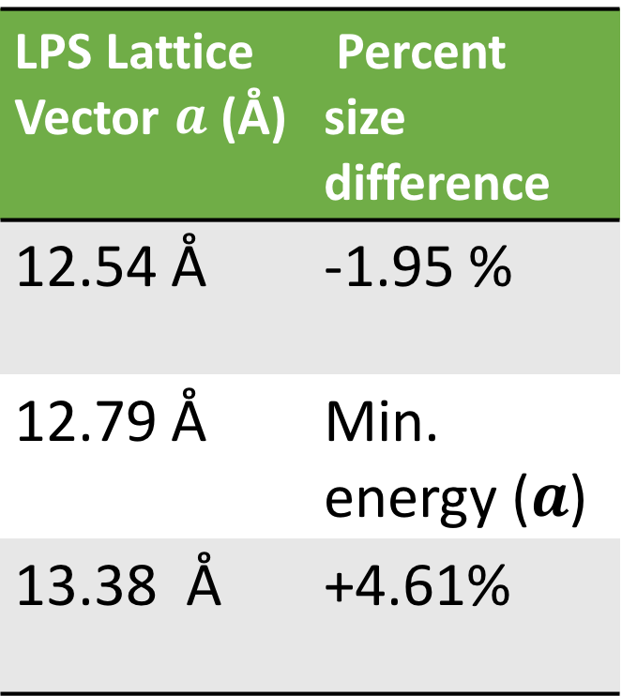
Volumes Studies: Does the larger volume of the amorphous phase lead to greater conductivity?
LPS simulated at three sizes
Minimum energy volume = 12.79 Å
Look at the effect of smaller and larger volumes than minimum
Larger volumes are a proxy for understanding the amorphous phase
LPS Lattice Vector $a$ (Å) | Percent size difference
12.54 Å | -1.95 %
12.79 Å | Min. energy ($a$)
13.38 Å | +4.61%
Notes:
To run a controlled study, we need to simulate the amorphous and crystalline phases at different volumes. We start with our crystalline data. We simulated the structure using QMD at three different volumes, where we only changed the length of the a lattice vector. These sizes correspond to the minimum energy cell size (point to table), a volume that is 1.95% small than the ideal volume, in addition to cell that is 4.61% larger than the ideal size. From this, we were able to use the largest size system as a proxy for the amorphous structure, since amorphous structures are generally larger than their crystalline counterparts.

Slide 15
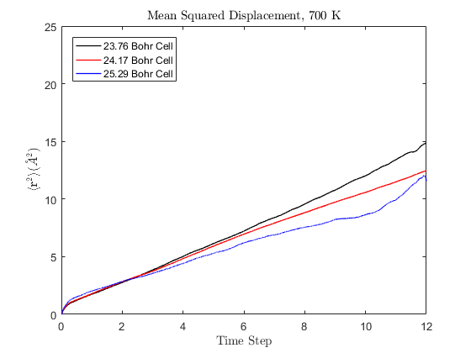
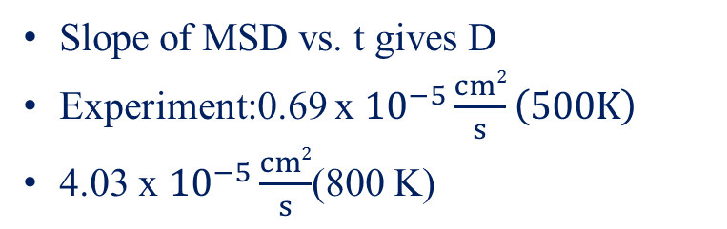
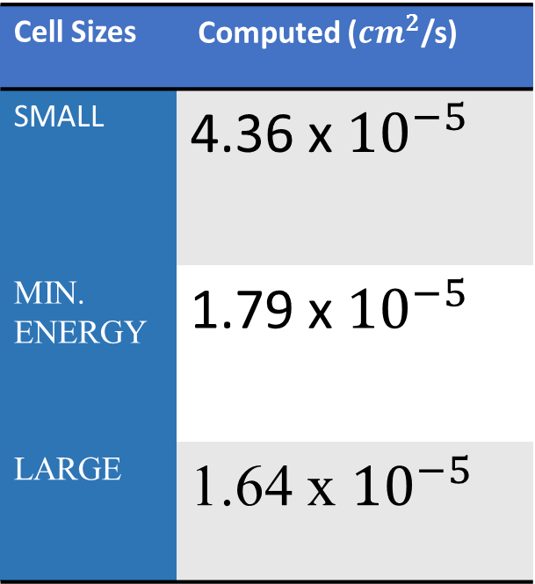
Large volume the driver for high amorphous conductivity? No.
Slope of MSD vs. t gives D
Experiment:0.69 x ${10}^{−5}\frac{cm2}{s}\left(500K\right)$
4.03 x ${10}^{−5}\frac{cm2}{s}$(800 K)
Cell Sizes | Computed (${cm}^{2}$/s)
SMALL | 4.36 x ${10}^{−5}$
MIN. ENERGY | 1.79 x ${10}^{−5}$
LARGE | 1.64 x ${10}^{−5}$
Notes:
And we found something interesting….
We discerned that Li diffusivity actually decreases in LPS, as volume increase. We were able to calculate the MSD of each system, and obtain diffusion coeffients from each by calculating the slope of each line, since the slope is related to diffusion coefficent. As indicated in this table, diffusivity decreases with increasing volume.
This shows that the increased volume in amorphous LPS could not possibly contribute to its anomalously high conductivity. So, we have to further examine the other two mentioned mechanisms.

Slide 16
Larger volume could give non-ideal Li-S bond distances
Cell Size a lattice vector | Percent Lattice Parameter Change | Percent Change in Peak Shift
23.76 Bohr | -1.3 % | 0.0%
24.17 Bohr | Minimum energy size | Minimum energy size
15.29 Bohr | 4.6 % | 6.4%
Not the entire picture, but its likely short Li-S bonds lead to faster diffusion.
Paddle-wheel mechanism?
Notes:
It seems likely that shorter Li-S bonds leads to faster diffusion, which would make sense if the Li was passed from tetrahedra to tetrahedra in a paddle-wheel mechanism. However, this cannot be the entire pictures, since the smallest volume has the highest conductivity but the same Li-S bond length has the minimum energy volum
To better understand the structure of our various sized systems, we calculated the LiS PCFs for all. By observing the peak first sharp peak of each PCF, we could determine average Li S bond lengths, hence we can see the effect of large increases in volume on the Li-S bond distances. This table compares percent changes in cell volume to percent changes in peak shift. As you can see, small changes in volume between the smallest cell and minimum energy cell leads to neglible changes in average LiS bond distances. However, as we increased the volume by larger percentage, we found noticeable changes in LiS bond distance.

Slide 17
Correlation, disorder, and amorphous LPS
The activation energy (low barriers between tetrahedral site) cannot solely explain the outstanding diffusivity in LGPS compared to LPS.
Larger volumes do not improve diffusivity in LPS.
Future work:
Compare diffusion mechanisms in the amorphous phase and crystalline phase at different volumes.
Compare correlated motion in LGPS and LPS, especially the effect of the lattice: polarization of sulfur ions and PS₄, rotation of PS₄

Slide 18
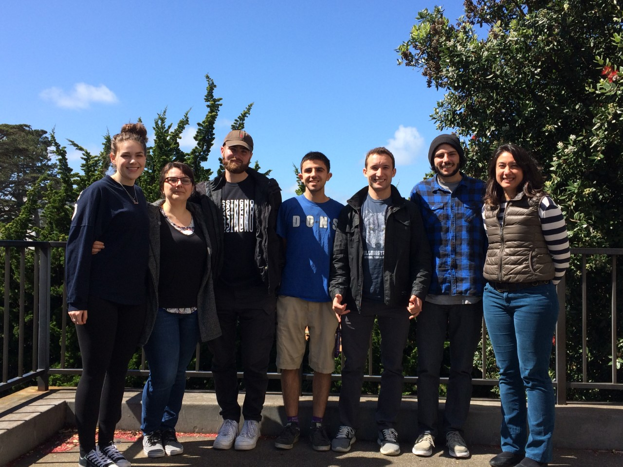

Thanks!
SFSU & LLNL
The authors acknowledge funding from Lawrence Livermore National Laboratory
Alex Hall, COMP 281 :West Hall 6:00-8:00 PM
(LLNL) through Directed Research and Development Grant 15-ER-022 and computing through the Grand Challenge Request. Helpful discussions with B. Wood, J. Varley, P. Shea, P. Mehta, A. Hall, and A. Zevgolis are appreciated.
Department of Chemistry and Biochemistry
Emails
Nima, nlecler1@mail.sfsu.edu
Nicole, nicoleal@sfsu.edu
San Francisco State University
1600 Holloway Avenue
San Francisco, CA 94132
Notes:
I would like to acknowledge my PI: Nicole Adelstein and colleigues at SFSU: Alex Hall and Alysia Zevgolys for making the data analysis and simulatiosn in the project possible.
In addition, I would like to thank our collaborators Brandon Wood, Joe Varley, Patrick Shea and Prateek Mehta at LLNL and LLNL as whole for allowing us to use their supercomputer through the Grand Challenge Request.
Lastly, thank you for coming to this talk. I will now gladly answer any questions.

